Slide 1

Implementation Science
Cliff Notes 101
Faye S. Taxman

Slide 2
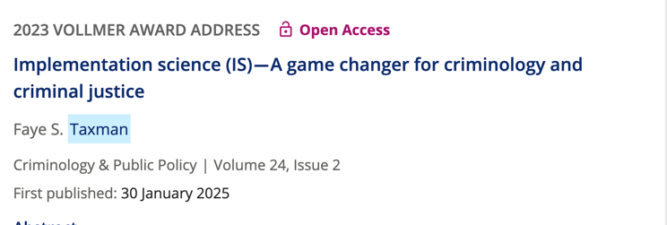
Today’s Outline
What is Implementation Science?
Implementation can tell us about effective change practices
Outcomes Related to Change at the Organizational Level
IS’s Added Value

Slide 3
What is Implementation Science?

Slide 4
Implementation Science is..
Implementation science provides methods to study how to get new policies/practices adopted, adapted, & sustained.
The focus is on the organization(s):
Change strategies
Measuring change in processes & outputs

Slide 5

Implementation Science Advantages
Advantage: used in any scenario with any problem
Allows staff to be engaged
Improves staff skills
Empowers and advances office practices and office culture

Slide 6
Implementation Research Framework
IMPLEMENTATION STRATEGIES
Systems
Environment
Organizational
Group Learning
Individual
Providers
Consumers
OUTCOMES
IMPLEMENT SERVICE INDIVIDUAL
Acceptability Efficacy Recidivism
Feasibility Safety Symptoms
Fidelity Equity Satisfied
Penetration Proc
Sustainability justice
Uptake
Costs
Innovation
EVIDENCED BASED PRACTICES
Improvements
Implementation Research Methods
Proctor, et al., 2009

Slide 7

Consolidated Framework for Implementation Research (CFIR) https://cfirguide.org/
5 Domains
Innovation or Ideas Introduced
Inner Setting: probation office
Outer Setting: courts, treatment agencies, government
Characteristics: People involved in the change process
Change Processes (ERIC): Ways to Make Change to be effective
Damschroder, L.J., Reardon, C.M., Widerquist, M.A.O. et al. The updated Consolidated Framework for Implementation Research based on user feedback. Implementation Sci 17, 75 (2022). https://doi.org/10.1186/s13012-022-01245-0

Slide 8
Innovation in France: Reentry Procedures
Identify innovation issues
1
Identify outer settings
2
Identify inner setting
3
Identify individual characteristics
4
Identify change processes
5
What are the obstacles? What helps in reentry?
How can we strengthen reentry efforts?

Slide 9
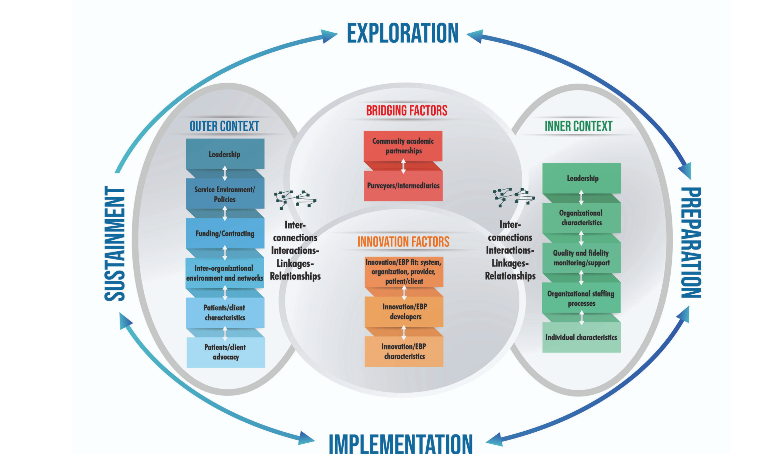
Exploration, Preparation, Implementation,
Sustainability (EPIS) Framework
https://episframework.com/

Slide 10
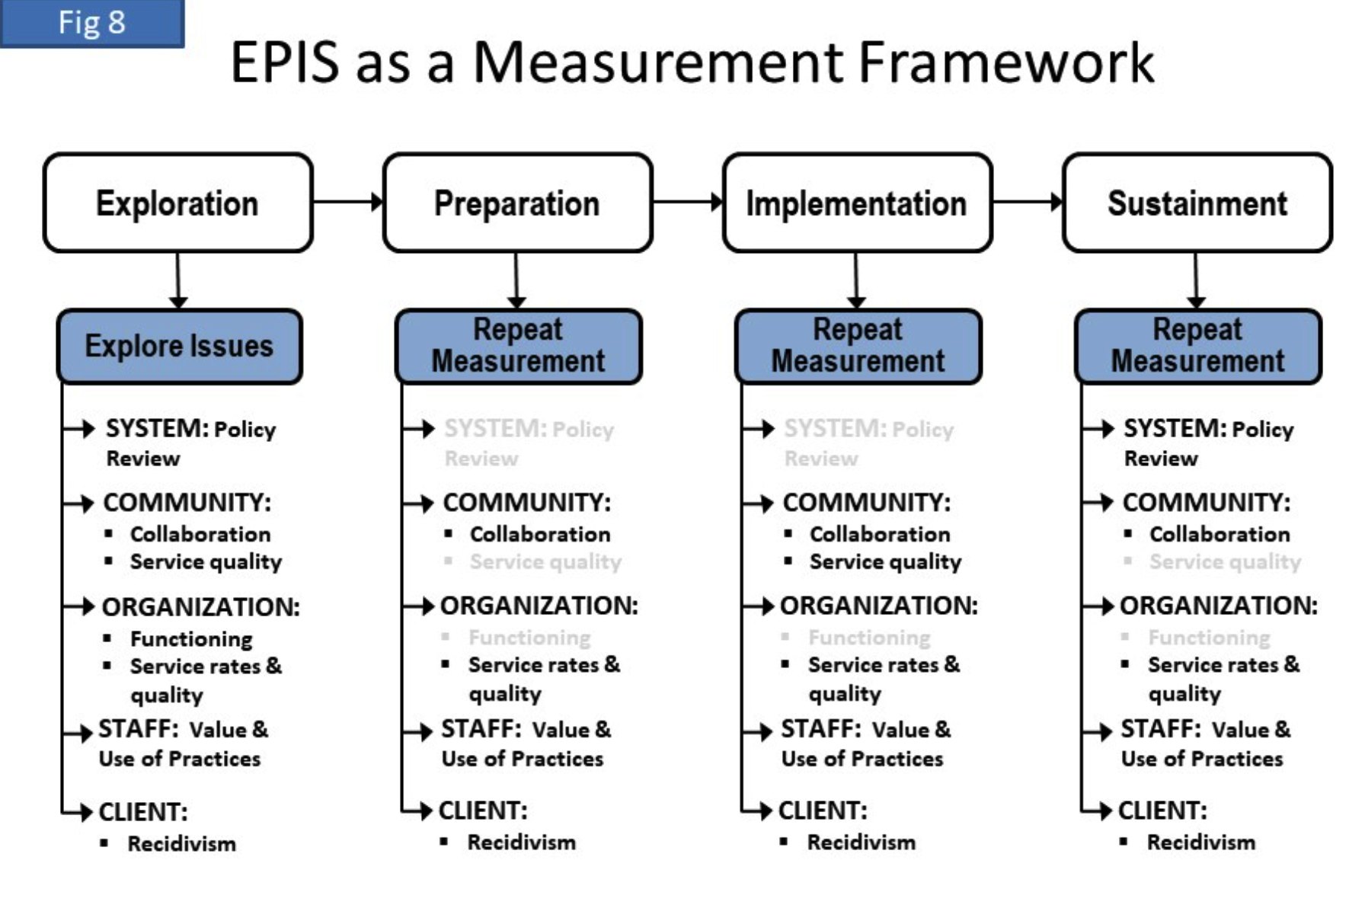
Knight, D.K., Belenko, S., Wiley, T. et al. Juvenile Justice—Translational Research on Interventions for Adolescents in the Legal System (JJ-TRIALS): a cluster randomized trial targeting system-wide improvement in substance use services. Implementation Sci 11, 57 (2015). https://doi.org/10.1186/s13012-016-0423-5

Slide 11
Implementation can tell us about effective change practices

Slide 12
Expert Recommendations for Implementing Change (ERIC) list of strategies
Powell et al 2015: This article lists all 73 ERIC strategies with short descriptions.
Waltz et al 2015: This article groups 73 ERIC strategies into 9 clusters based on concept mapping methods.
Perry et al 2019: This article lists recommended refinements to the list of ERIC strategies based on findings from the ESCALATES National Evaluation.
CFIR-ERIC Matching tool was developed based on survey responses from “implementation experts” (n=169)

Slide 13
Implementation Strategies vs Mechanisms
The study of mechanisms examines how a strategy works within a given context.
Study of strategies helps to “determine what information from new contexts are needed to infer across contexts, and if that information is available, what those effects would be — thereby advancing generalizing in implementation research” (Geng and colleagues (2024, pgs 1 and 2).
Geng, E.H., Powell, B.J., Goss, C.W. et al. When the parts are greater than the whole: how understanding mechanisms can advance implementation research. Implementation Sci 20, 22 (2025). https://doi.org/10.1186/s13012-025-01427-6

Slide 14
Typical Implementation Strategies
Policy Teams
Data Driven Decision Making
Learning Collaboration
NIATx/Quality Improvement Processes
Training
Technical Assistance

Slide 15
Reentry—a quality improvement process to develop change
Small activity on implementing reentry processes using quality improvement works
Use quality improvement to improve reentry issues during prison, transition and supervision
Define office “practices”—good, bad, or ugly
Define preferred practices according to officers? Individuals on probation?
Develop champions in the office
Work on messaging
Identify how to improve operations (no more than 3)

Slide 16

Outcomes Related to Change at the Organizational Level

Slide 17
Implementation Research Framework
IMPLEMENTATION STRATEGIES
Systems
Environment
Organizational
Group Learning
Individual
Providers
Consumers
OUTCOMES
IMPLEMENT SERVICE INDIVIDUAL
Acceptability Efficacy Recidivism
Feasibility Safety Symptoms
Fidelity Equity Satisfied
Penetration Proc
Sustainability justice
Uptake
Costs
Innovation
EVIDENCED BASED PRACTICES
Improvements
Implementation Research Methods
Proctor, et al., 2009

Slide 18
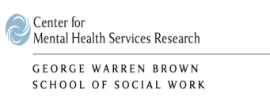
Implementation Measures
ACCEPTABILITY | Perception of the practice as acceptable based on experience with various dimensions of the practices, such as its content, complexity, comfort, comprehension, credibility, and/or delivery of the innovation
APPROPRIATENESS | Perceived fit
FEASIBILITY | The extent to which an innovation can be successfully carried out or is suitable for a given agency or setting
ADOPTION/UPTAKE | The intention or initial decision of an organization to try an innovation or evidence-based practice
PENETRATION | The proportion of users
SUSTAINABILITY | The extent to which an evidence-based intervention can deliver its intended benefits over an extended period of time after external support ceases
FIDELITY | The degree to which an intervention was implemented as it was prescribed in the original protocol : (1) adherence to the program protocol, (2) dose or amount of program delivered, (3) quality of program delivery, and (4) participant reaction and acceptance

Slide 19
Easy to Use Measures
Weiner, B.J., Lewis, C.C., Stanick, C. et al. Psychometric assessment of three newly developed implementation outcome measures. Implementation Sci 12, 108 (2017). https://doi.org/10.1186/s13012-017-0635-3
Acceptability
Appropriateness
Feasibility

Slide 20
Why is IS Important?
Context
Use of Innovation
Tied to client outcomes
Focuses on fidelity
Intensive Supervision Experiment (Petersilia & Turner, 1993)
Enhanced supervision contacts
more frequent contacts, drug testing, and sanctions
2. Findings: no difference in arrests between treatment group and control group;
slightly higher technical violations
3. Did not account for implementation
4. Few sites had very little difference in contacts between officers and clients
Proactive Community Supervision (Taxman, 2008)
Used RNR Principles of assigning conditions to risk and need areas
Findings: Reduced arrest rates for RNR group; reduced technical violations
Measured implementation in RNR regarding fidelity to RNR design
RNR group had fewer conditions
Conditions tied to risk level
Needs were highlighted
Probation Officers reported support for RNR model

Slide 21
IS’s Added Value

Slide 22
Why don’t we routinely use medications for individuals with SUD in the justice system?
Staff believe medications are just “another drug”
Staff believe people need to hit “rock bottom” to change
Stakeholders do not support these tools
No one knows how to best combine medications with other requirements
Giving medications will be another headache….people sell or divert them

Slide 23
Understanding Staff/Organization Issues Because….
Lack of Knowledge about:
Understanding Role of Medications for Opioid Disorders/Alcohol Disorders
Understanding what is effective in changing the behavior of individuals with specific SUD
Understanding policies of their agency (allowed or not allowed?)
Perception of how others will view endorsement of use of medications
Concerns about their own Skills to:
Ability to know when to use medications
Combine with other justice requirements
Manage medication and related behaviors
Responsible for adverse reactions
Implementation Science: the emphasis is on building a foundation and skills to handle situations differently. Change the culture to support this new foundation? Work on reforms to be sustained, not piloted.

Slide 24
Exploring Inner & Outer Settings for Medications
INTERNAL
Staffing
Policies
Procedures
Organizational Culture
Relationship between medical and security staff
Access to medications
EXTERNAL
Buy In about need for Services
Funding
Contracts & MOUs
Legislation/Policies
Commitment to Training and Resources
Innovation should focus on : Staffing, Policies, Organizational Culture, Relationship with Internal Staff,
Relationship with External Staff, Funding, Commitment to Training and Resources

Slide 25
Implementation Science Focuses on Systems Issues
Examines how to strengthen efforts to change
Addresses internal challenges
Addresses external challenges
Introduces new ways of achieving organization change
Serves to build support for new innovations

