Slide 1
CORRECTIONS+HEALTH
FAYE S. TAXMAN, PH.D.
GEORGE MASON UNIVERSITY
FTAXMAN@GMU.EDU

Slide 2
WHY Focus on Public Health in the Criminal Justice System?
CJS is not a service provider, yet over estimated 25+ million adults in any given year interact with the system
About 1 in 10 deaths occurring in prison are due to suicide (UNODC, 2024)
Overcrowding (in 60% of countries) creates health and human rights challenges.
No longer an anomaly—1:21 adults
Offenders are high need for SA, MH, and somatic care
“Life in CJS” involves churning through the system
Tend to be “treated” in critical situations—ER, booking stations/arrests, jail/prison
UNODC, Prison Matters 2024: Global Prison Population and Trends; A Focus on Rehabilitation (United Nations, 2024).

Slide 3
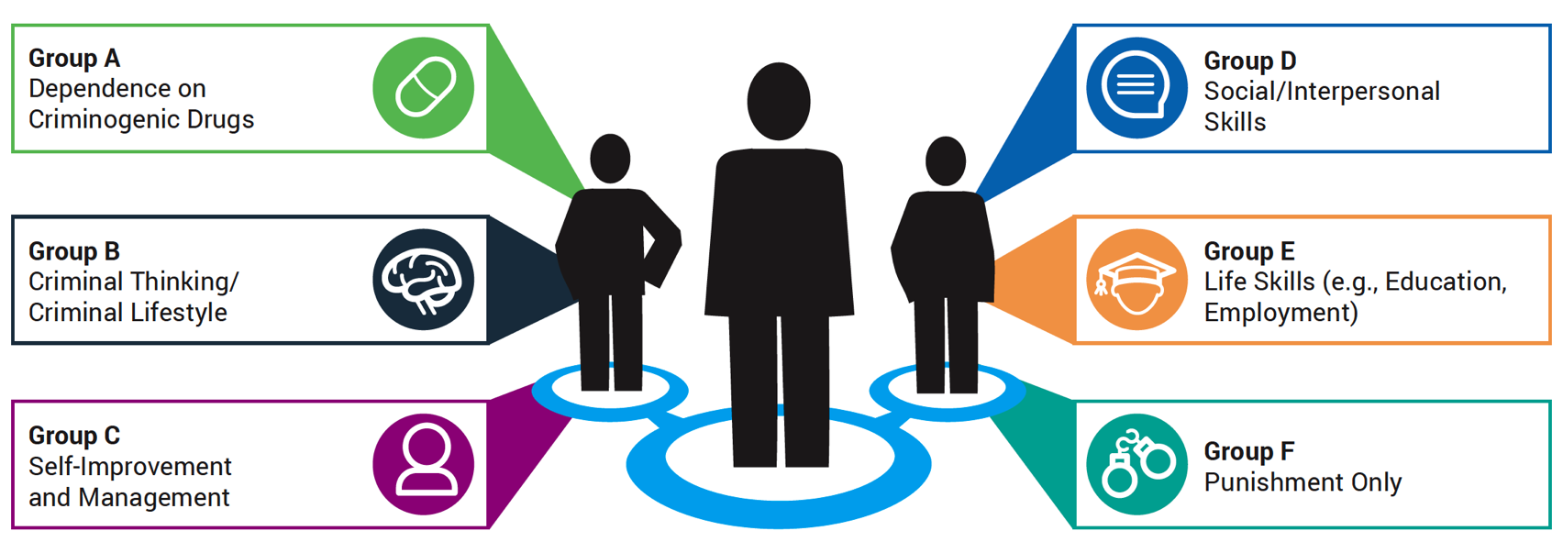
Link the Criminal Justice System with Other Health Care and Service Delivery Systems
Move from screening and assessment to clinical pathways
Why? A clinical pathway is a direct, proactive “placement” instead of referral (a process of providing direction proactively)
Recognize that individuals have
different needs, and that these
needs require different types of
services
Focus on constellation of problems
Improves treatment initiation
Facilitates integrated care and better
outcomes

Slide 4
Generations of Systems of Care
1. Manual Approaches with Justice and Health Personnel Use
2. Integrate Clinical Skills
3. Use Practice Guidelines to inform
Standardized Instruments
Trained in Case Management
Screening, Brief Intervention, Referral, Treatment (SBIRT)
On-Line/Computerized interventions
Decision Pathways
Refer to Agencies Agreed Upon by Corrections/Health
Proactive Interagency Efforts
Continency Management
Trained in Cognitive Behavioral Techniques
Motivational Interviewing
Apps, Information Driven
Low Uptake in Referrals/
Treatment Initiation

Slide 5

Social Determinants of Health:
Economic Stability: Income, employment, food security, and housing stability all play a crucial role in health.
Education: Educational opportunities, literacy, and language skills influence health knowledge and access to resources.
Social and Community Context: Social support networks, community cohesion, and experiences of discrimination or racism impact mental and physical health.
Health Care Access and Quality: Availability of and access to quality healthcare services is essential for preventative care and managing illnesses.
Neighborhood and Built Environment: Factors like housing quality, access to transportation, and exposure to environmental hazards can affect health outcomes.

Slide 6





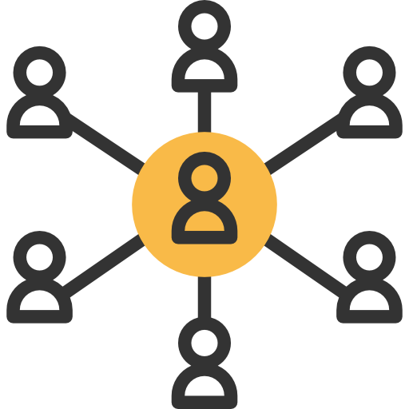
Social Determinants of Health (SDOH)
Work encourages taking on responsibilities and engages youth in productive activities
Community provide youth with social capital which ensures a connection with society
Health (Physical Activity) provides self-confidence, experience of success, emotional and psychological development.
Education focuses on providing youth with opportunities for learning and implementing new skills
Relationships give youth a sense of belonging, and shape their behavior
Creativity (dance, theater, poetry) give youth competence and ability to express oneself
Develop assets within these six domains to contribute to productive citizens
Notes:
Butts and colleagues (2010) then recommended six practice domains (areas youth can/should focus on to get them on the right track) in which juvenile justice system could work to develop the two core youth assets (Butts et al., 2010). With these six domains, practitioners can design interventions and construct outcome measures. The six domains are: 1) Work; 2) Education; 3) Relationships; 4) Community; 5) Health, and 6) Creativity. For examples of aligning small steps, larger goals and Butts’ six practice domains please refer to Appendix P.

Slide 7
Static Risk: How do we define it?
Empirical research has found that some Static Risk factors (shown right) impact the likelihood of reoffending. Static Risk factors are unidirectional (never decrease). |  | Static Risk Factors: Age at time of ­first arrest Number of prior arrests Type of criminal history (i.e. previous convictions) Number of times on probation Number of probation violations Number of probation revocations Age at time of first incarceration

Slide 8
Criminogenic Needs
Dynamic risk factors that can be changed are often referred to as criminogenic needs.
These are related to risk of recidivism
The major Criminogenic Needs are:
  Low Self Control
  Criminal Cognitions
  Anti- Social Personality (Criminal Personality)
  Anti- Social Values
  Criminal Peers (Antisocial associates)
  Substance Abuse
  Dysfunctional Family
  Leisure Time

Slide 9
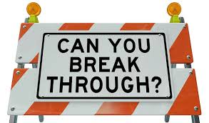
SDOH can be DESTABILIZERS to behaviors and contribute to more criminality
Destabilizers are factors make it difficult for the client to focus on and benefit from treatment programming and controls
Lack of Family Support: Few or no positive relationships.
Lack of Education: GED or less than a high school diploma.
Less than Full-Time Employment: Less than 30+ hours of work per week.
Unstable Housing: Homeless or “couch surfing”
Drug Abuse: A negative pattern of use of a substance
Alcohol Dependence
Mental Health History
9

Slide 10

Addressing SDOH can affect STABILIZERS (Strengths)
Stabilizers are factors that increase the likelihood of success
Family Support: Having positive relationships with family members.
Education: High school diploma or higher education.
Full-time Employment: 30+ hours of work per week for a consistent period of time.
Lack of Criminal Networks: No friend or family with criminal ties/history.
Stable Housing: Not homeless/having a place to live
10

Slide 11
SDOH+Stabilizers+Destabilizers: What does this approach mean?
Holistic approach, recognizing the role of different agencies
Reduce service silos—corrections and health do their ”thing” which can conflict, complement, or even create tension
Present unified set of goals
Recognizes that behavior change is multidimensional
Emphasize human capital development—increase citizenship and productivity
Emphasize social capital

Slide 12





A Holistic Approach to Behavior Change
Individual
Organizational
System
Program
Quality programming
Treatment matching
Sufficient dosage
Various Types of Individuals
Tailoring to the Individual
Staffing
Implementation
Ensure capacity
Enhance communication between systems
Data tracking systems
Shared knowledge about provider networks

Slide 13
Seamless System of Care
Screening/Diagnosis Drives Case Plan
CJ screening inform health
Health inform CJ
Information is shared throughout service period
Emphasize common goals
Case Plan
Prioritize action items
Complements both Corrections/Health
Emphasis on individual behavior change over accountability
Outcomes
Emphasize clinical progress unless engage in serious criminal behavior
Incentive clinical progress
Minimize use of sanctions

Slide 14
Peer Supports
Peer supports are people with lived experience to augment the officers
Support strategies used in individual supervision sessions, group consultations, and training session increased psychological safety, peer connection, skill building, and emotional resilience
Recognition of PRCs as professionals is essential
Peer navigation has been empirically supported for Mental Health and HIV linkage facilitation and other key recovery outcomes. Less empirical work has been done for OUD patients and outcomes.
  Peer Recovery Coaches (PRCs) decreased time to MOUD initiation by nearly 60 days for patients discharged from the ED following non-fatal overdose.
Informal teleconference meetings can support the implementation of peer support services for opioid overdose patients in emergency departments, by allowing health service workers of different organizations to regularly engage experts and each other during implementation.

Slide 15
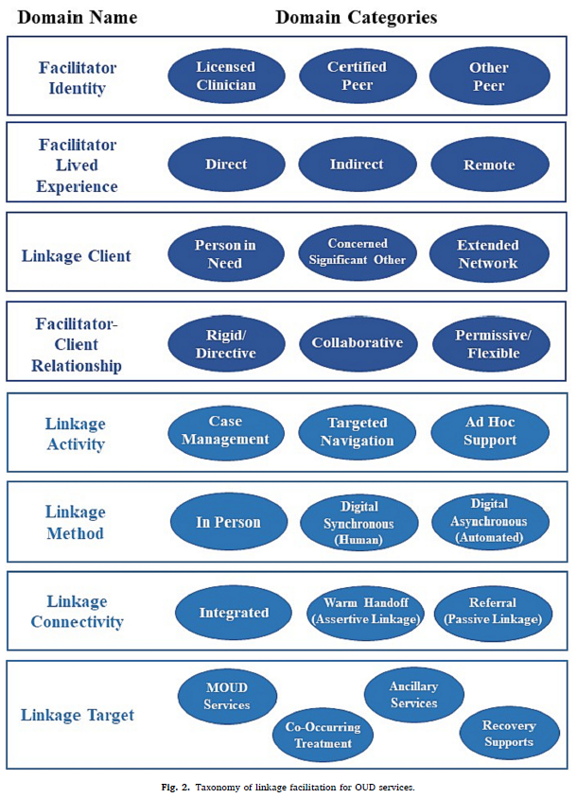
Peer Supports
Hogue, A., Satcher, M. F., Drazdowski, T. K., Hagaman, A., Hibbard, P. F., Sheidow, A. J., ... & Stein, L. A. R. (2024). Linkage facilitation services for opioid use disorder: Taxonomy of facilitation practitioners, goals, and activities. Journal of substance use and addiction treatment, 157, 209217.

Slide 16

Role of Incentives
The relationship a person has with officer is a critical, and powerful tool to effect positive behavioral change.
Incentives and other forms of positive reinforcement can help build relationships and work together more effectively
Positive reinforcements have been found to
reduce substance abuse
improve treatment retention
facilitate housing and employment stability
improve mental health functionality
reinforce target behaviors
serve to assist individuals to make steps to desired behaviors.

Slide 17

Balance Theory | Magic Ratio
Positive
Praise
Love
Support
Active Listening
Engagement
Being Present
Caring
Compassion
Negative
Guilt
Punishing
Not Caring
4:1
Gottman, J., Gottman, J. M., & Silver, N. (1995).
Gendreau (1996) recommended using 4:1 reinforcement to sanction ratio in adult criminal justice settings. For juvenile justice settings, we emphasize a higher positive reinforcement ratio to promote positive behaviors.

Slide 18


Lens Switching
Focuses more on incentivizing and rewarding positive behavior
Less on sanctioning and punishing negative behavior
Acknowledges positive behaviors
Works on creating steps to achieve positive behaviors
Focus on growth in key areas—education, employment, relationships, health, creativity, and self
Infusing Contingency Management into workplace routines will assist in switching perspectives to emphasize development and growth, human productivity
Notes:
Lillian what does NOT IN MANUAL MEAN????

Slide 19




Features of Contingency Management
Behavioral contract that identifies long-term goal(s) and short-term target behaviors (steps) to obtain the long-term goal(s).
Develop a list of responses (rewards) that each target behavior earns and for sustaining the each behavior over time.
Minimize the use of sanctions; if used, sanctions need to be fair, swift, and certain with an explanation of why/how this occurred and how they can avoid sanctions in the future. Sanctions should not be used for minor nuisance behaviors.
Deliver responses (both rewards and sanctions) swiftly and certainly according to a rewards schedule/protocol. Rewards should be used for positive behavioral changes.
Notes:
Develop a behavioral contract that identifies long-term goal(s) and short-term target behaviors (steps) to obtain the long-term goal(s). Involve the youth (and their family, if possible) in this process to ensure agreement with the steps, goals and rewards.
Develop a list of responses (rewards) that each target behavior earns and for sustaining the each behavior over time. The goal is to use rewards for sustained behaviors and to use sanctions minimally.
Deliver responses (both rewards and sanctions) swiftly and certainly according to a rewards schedule/protocol. Minimize the use of sanctions for youths, but when used, sanction youth fairly, swiftly and certainly with an explanation of why/how this occurred and how they can avoid sanctions in the future (using sanction schedule/protocol). Remind youth that rewards are available for positive behavioral changes.

Slide 20
5 Goals of Contingency Management
Establish & Negotiate Realistic Short-Term Goals
1
Support Behavioral Change Through Rewards
2
Increase Attention to Positive Behaviors That Facilitate Youth Growth
3
Instill a Sense of Fairness (Reward and Sanction Schedules)
4
Sustain Behavior Change
5

Slide 21



Increase Attention to Behaviors That Facilitate
“Catching People Doing Things Right”
Reinforces Positive Behavior
Helps individuals repeat positive behavior to achieve rewards. Increases the likelihood of continuing in this behavior
Focuses attention on positive behavior early. Reinforces the importance of positive behavior.
21
Friedmann, Katz, Rhodes, Taxman, O’Connell, Frisman, Burdon, et al., 2008

Slide 22
Memorandum of Agreement
Advances Program and Client Outcomes
Solidifies Relationship
Goal Consensus: Importance of TX and Progress Reports
Eligibility Criteria
Definition of Progress
Information Sharing
Boundaryless staff who work for both agencies
Success criteria
Sample template: https://cops.usdoj.gov/pdf/tribal_training/MOU_MOA/Templates_and_Reference_Documents/Fillable_Template_MOA.docx

