Slide 1

Evidence-based/Informed Practices
Faye S. Taxman, Ph.D.
George Mason University
ftaxman@gmu.edu

Slide 2
Why evidence-based/informed practices?
Evidence-based/inform refers to practices that have been shown to produce positive outcomes.
Requires more than one study, usually refers to 10+ studies
Often uses systematic reviews that synthesize the research
Usual outcomes refers recidivism (rearrest, reincarceration)
Why would we not want to use practices that are based on producing good outcomes?
Ensures that the practices are not based on “gut”
Allows officers to have a toolkit of responses

Slide 3

What Defines Evidence in EBPs?
Practice
Knowledge Development
Evidence Informed
Best Practices
EBP
No Research
Post Hoc Test
Quasi-Experimental Designs
Randomized Trial
Randomized Trials (2+) Systematic Reviews

Slide 4
What works in corrections?
RISK_NEED_RESPONSIVITY=Core Correctional Practices
5 Key Components
Standardized screening tool ensures that similar information is being used to make decisions
Match client-level needs to appropriate services
Address risk of future involvement
Address criminogenic needs of criminal activity, criminal values, criminal history, substance use, family destabilization, employment/literacy, and leisure activities
Address stabilization issues of f housing, transportation
Engage in evidence-based programming
Group work helps clients learn from each other
Sufficient timeframe to help clients change (6+ months)
Incentive engagement in treatment/services to improve compliance and positive outcomes
Change behavior by incentivizing individuals to change
Minimize use of sanctions since they increase defiance
Build a relationship between officer and client

Slide 5
Evidenced Based Practices Lead to Better Positive Outcomes
Intensive Supervision
Boot Camp
Case Management
Incarceration
Diversion to TX with 12 Month Residential
Tx with Sanctions
Drug Courts
RNR Supervision
In-Prison Tx (TC) with Aftercare
Contingency Management
Education (Psycho-Social)
Non-Directive Counseling
Directive Counseling
Motivational Interviewing
Moral Reasoning
Emotional Skills
12 Step with Curriculum
Cognitive Processing
Cognitive Behavioral (Social Skills, Behavioral Management, etc.)
Therapeutic Communities
Medically Assisted Treatments

Slide 6
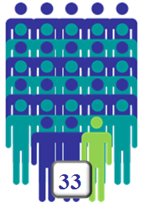
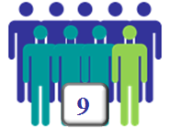
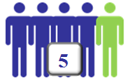
Impact of Approaches
Number Needed to Treat (NNT) to prevent one person that recidivates
Incarceration & Controls
Evidence-Based Treatment Program
Risk-Need Profile—EBP for TX and CJ
Source: Caudy, Tang, Ainsworth, Lerch, & Taxman, 2012; Cook & Sackett, 1995; Heller, Edwards, & McElduff, 2003
Notes:
Calculation based on 3-year rearrest rates from BJS 1994 recidivism and treatment effectiveness findings from meta-analyses reviewed by Lipsey and Cullen 2007 and Bonta and Andrews 2007. The results depicted in Table 3 are based on a hypothetical offender population of 10,000 individuals in one jurisdiction. A conservative estimate of baseline recidivism risk of .60 was used in this model based on the Bureau of Justice Statistics (BJS) 1994 recidivism study which found that over two-thirds (67.5%) of all released prisoners were rearrested within three years (Langan & Levin, 2002). The relative risk reduction (RRR) associated with correctional treatment was specified as .20 (a modest effect) consistent with the meta-analytic findings reviewed by Lipsey and Cullen (2007). The proportion of offenders currently receiving treatment was specified as .10 based on the findings of Taxman and colleagues (Taxman et al., 2007a; Taxman & Perdoni, 2009 (and in Chapter 2 of this book)).

Slide 7
If you had to prioritize, what should you do?
Build relationships
Focus on trust
Build caring
Emphasize fairness
Incentive behavior
Reward compliance
Acknowledge small steps of progress such as attend treatment, attend sessions, maintain work, maintain housing
Focus on matching needs (all types) to appropriate programs
Emphasis programs/services that address the major criminogenic and stabilization needs

Slide 8
If you don’t have one of the EBPS, you have options…
Standardized screening tool then you should
Emphasize the nature of criminal behavior such as sexual offending, illicit drug use, personal violence
Prioritize individuals that have had more than 3 interactions with the legal system
Focus on substance use behaviors, mental illness, housing instability since these are destabilizing
Wide range of treatment or cognitive behavior treatment
Emphasize problem solving skills
Focus on treatments the client desires—prioritize based on individual choice
Incentives, then you can use officer given rewards
Certificates of completion
Letters of praise
Reduce supervision contacts
Reduce other conditions

Slide 9
Tools to Advance the use of RNR
Practice Guidelines—Appropriateness Statements
Treatment Matching Tools

Slide 10
Practice Frameworks (Policy Guidance)
Standard Operating Procedures tell what to do but not why
SOPs don’t deal with the operational procedures that are barriers to implementation
More attention is needed to defining
What the research says (plain language)
Where is the work process should this occur
How to use it
Perspective on staff, justice involved individuals, stakeholders
Communications—how to address difficult issues
Other items—definition of key terms, etc.
Reduce harms through variation in officer response
Adherence to RNR/CPP can be achieve through clear guidance

Slide 11
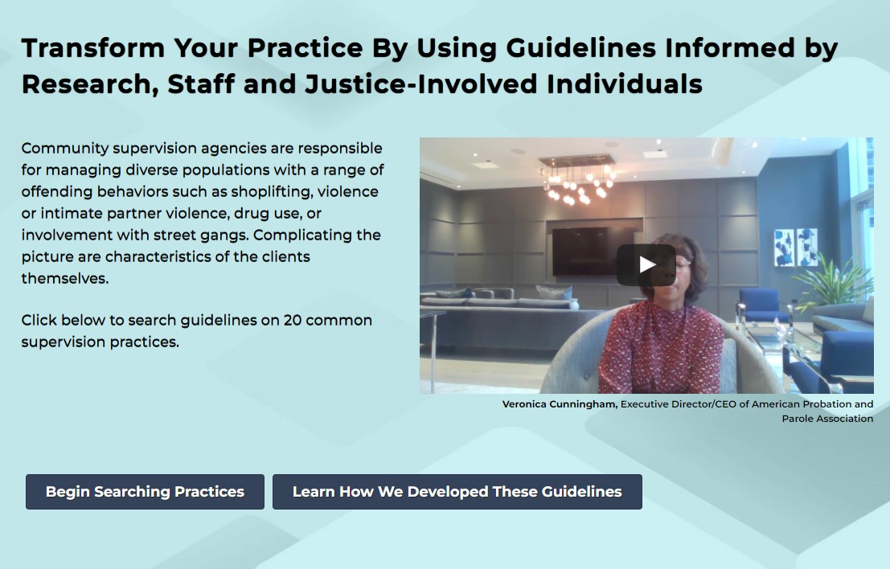
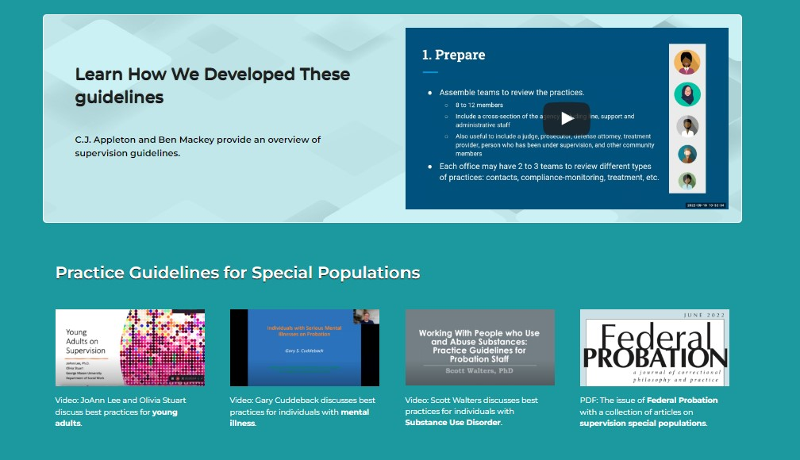
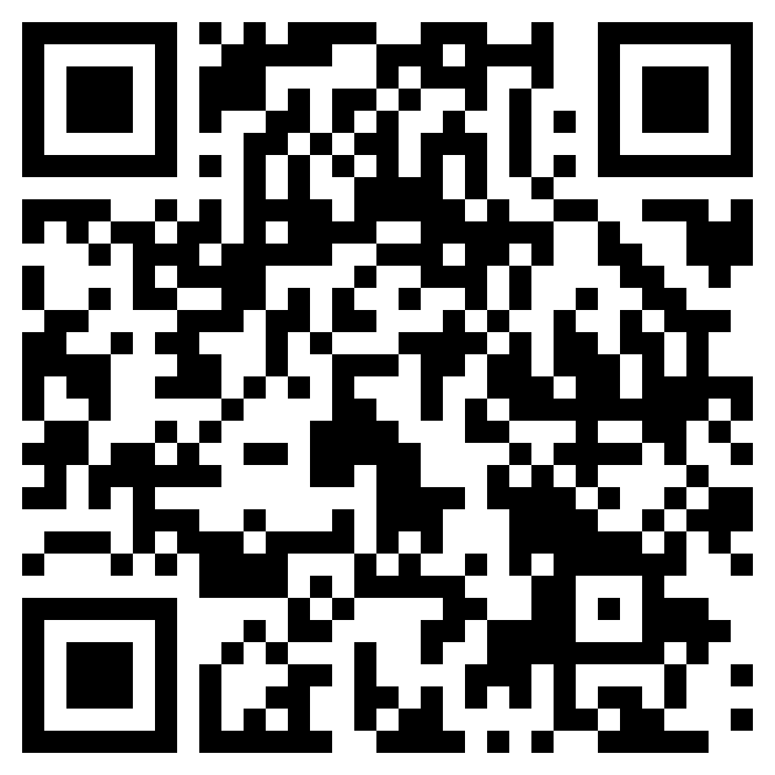
The Appropriateness Statements Package
Access Here!
gmuace.org/appropriateness-statement-package
Notes:
Ben

Slide 12
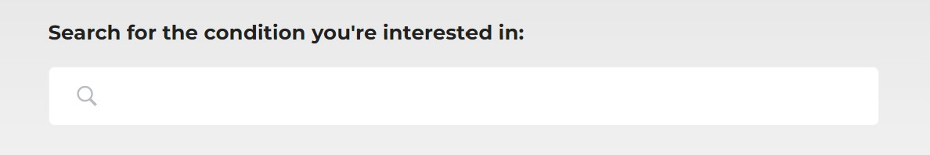
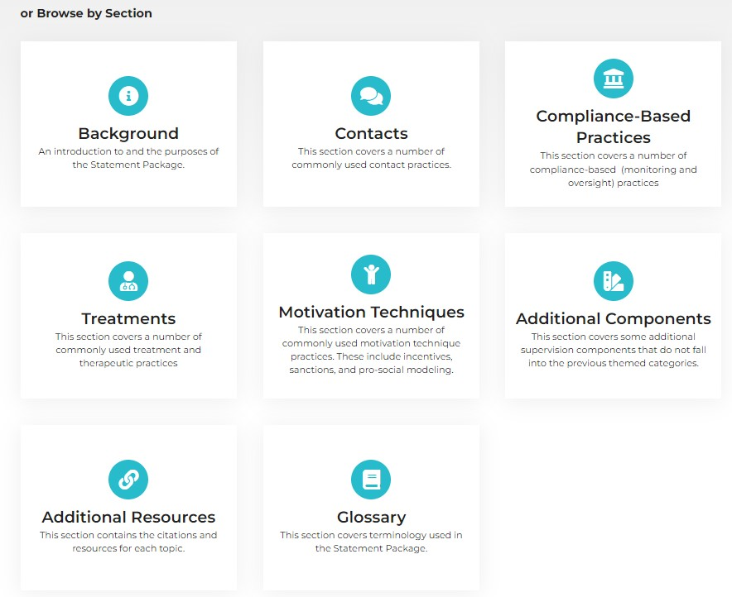
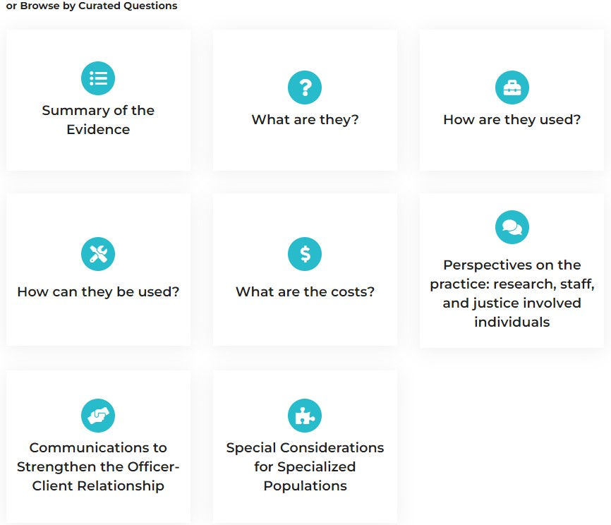
Searching Appropriateness Statements
Access Here!
gmuace.org/appropriateness-statement-package
Notes:
Ben

Slide 13
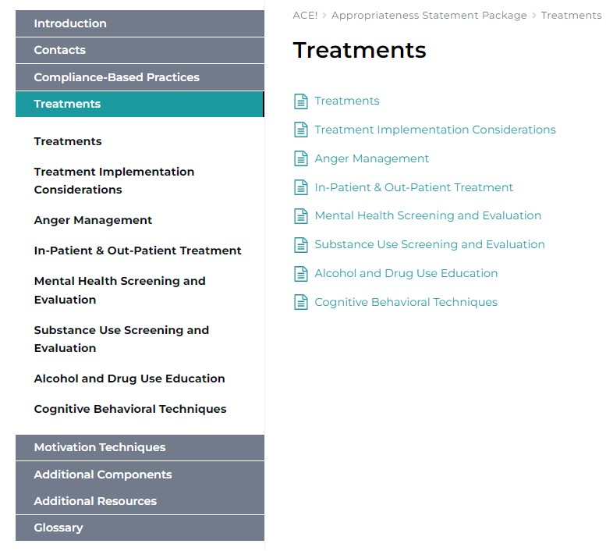
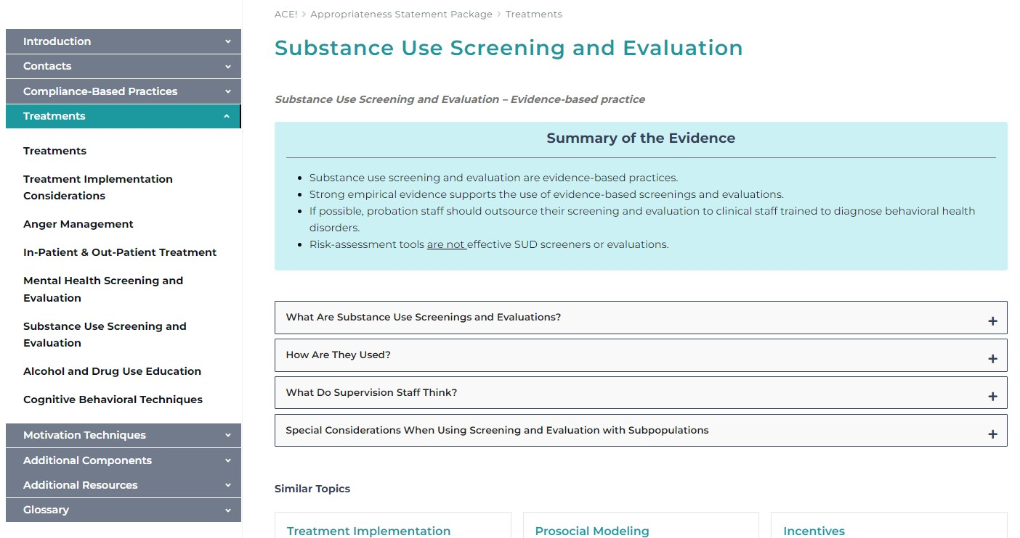
Using Appropriateness Statements
Access Here!
gmuace.org/appropriateness-statement-package
Notes:
Ben

Slide 14
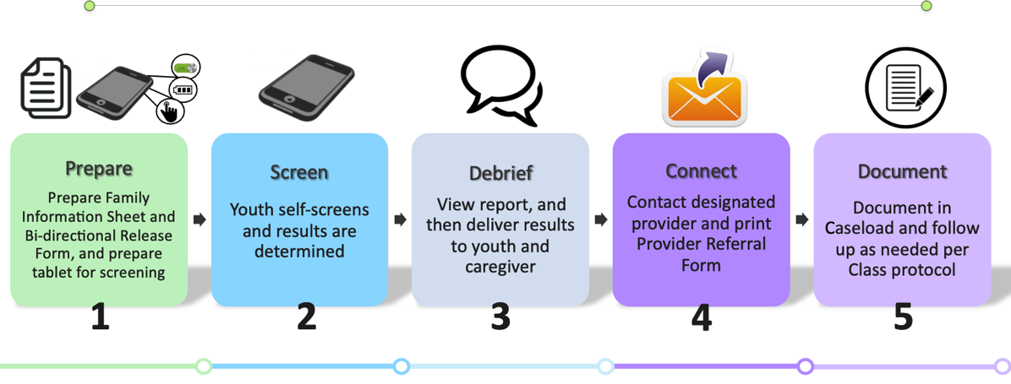
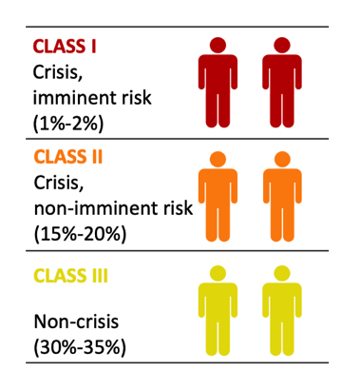
Practice Guidelines
Establish set procedures as to what are the best treatment options based on screening and assessment.
Pathways Based on Screening
Wasserman, et al., 2021

Slide 15
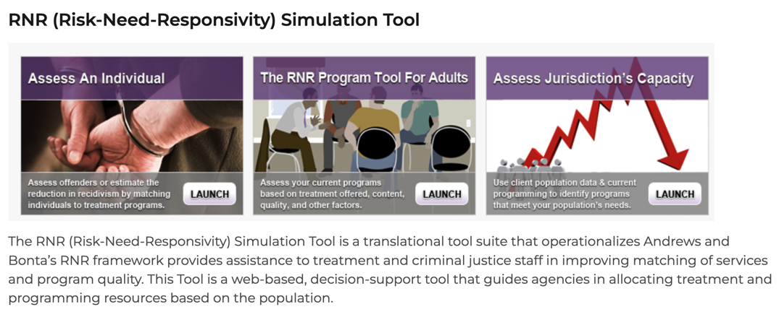
RNR Simulation Tool
https://www.gmuace.org/major-projects/rnr-simulation-tool/
17 Questions
Do not need a risk-assessment tool
Focuses on individual characteristics

Slide 16

Risk: Static Risk
Risk is the likelihood that a client will engage in further criminal behavior.
Static risk factors impact an individual’s likelihood of re-offending. These factors can increase but cannot decrease.
Risk does not refer to dangerousness or violent
Criminal History
Age at time of ­first arrest
Number of prior arrests
Type of criminal history (i.e. previous convictions)
Number of times on probation
Number of probation violations
Number of probation revocations
Age at time of first incarceration
STANDARDIZED RISK TOOL
16

Slide 17

Risk: Dynamic Risk/Criminogenic Need
Criminogenic needs are dynamic risk factors related to criminal behavior that can be changed.
Reducing these risk factors results in reducing criminal behavior.
STANDARDIZED NEED TOOL (and add on Substance Use and Mental Health Information)
Criminogenic Need
Low Self Control
Anti-Social Personality
Anti-Social Values
Criminal Peers
Substance Dependence
Dysfunctional Family
Educational/Employment Deficits
17

Slide 18

STABILIZERS (Strengths)
Stabilizers are factors that increase the likelihood of success
Family Support: Having positive relationships with family members.
Education: High school diploma or higher education.
Full-time Employment: 30+ hours of work per week for a consistent period of time.
Lack of Criminal Networks: No friend or family with criminal ties/history.
Stable Housing: Not homeless/having a place to live
18

Slide 19
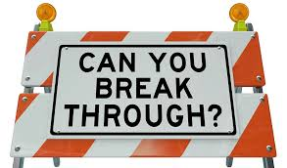
DESTABILIZERS
Destabilizers are factors make it difficult for the client to focus on and benefit from treatment programming and controls
Lack of Family Support: Few or no positive relationships.
Lack of Education: GED or less than a high school diploma.
Less than Full-Time Employment: Less than 30+ hours of work per week.
Unstable Housing: Homeless or “couch surfing”
Drug Abuse: A negative pattern of use of a substance
Alcohol Dependence
Mental Health History
19

Slide 20
Responsivity Principle
The Responsivity Principle requires staff to combine controls and treatment to address the Static Risk and Criminogenic Needs
Programming should be cognitive-behavioral in modality and consider the client’s learning style, level of motivation, and gender/ethnicity.
For low IQ or mental challenges, incentives are a useful tool
Therapeutic community environments/milieus are important for those that are low motivation, lower IQ and more lifestyle isses
CBT works best for those with at least a 10 grade reading level (or higher)
Services should target Criminogenic Needs and destabilizers

Slide 21
Responsivity Principle
Responsivity Principle states that recidivism is reduced when the intensity and duration of interventions are matched with the client’s risk to reoffend
Dosage is important—how long?
Depends on problem severity and risk level
Should focus on longer term problems for those with more serious problem severity
Can include multiple levels of care including therapeutic + life skills+
Housing stability
Notes:
Ask why programming should target the dynamic risk factors? Because dynamic risk factor or criminogenic needs can increase or decrease right?

Slide 22
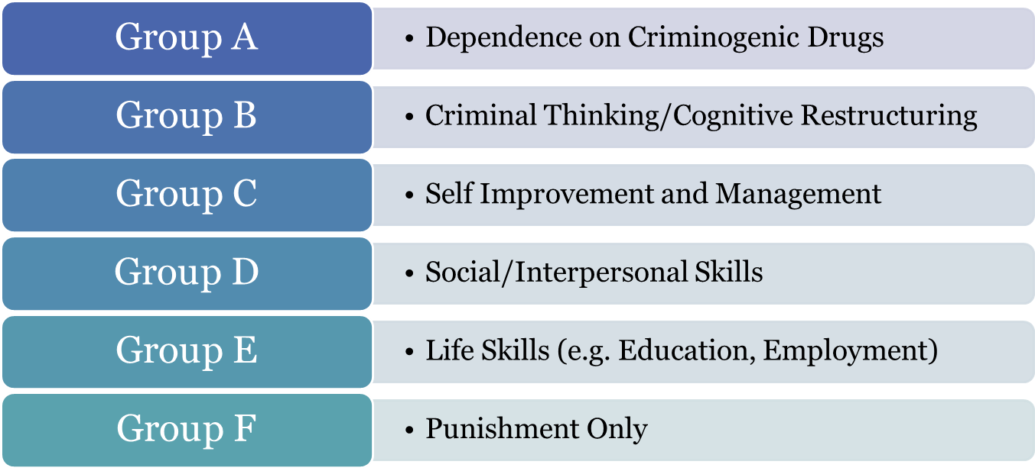
Target Behaviors
Six program groups based on specific target behaviors
RISK Levels Needs Stabilizing Factors
Notes:
The RNR program tool classifies programs into one of six different program groups to guide Responsivity. These six categories represent the restrictiveness, dosage, and content of the program. Dosage is one of the key features that distinguishes between the program groups. For example Cognitive-Behavioral Treatment and Therapeutic Communities can be included in multiple program groups with the differentiation between the group being the dosage of the program received by a participant. For example, the dosage of the program can influence the group the program is placed in, and poor quality can reduce the expected effectiveness of the program within the group.

Slide 23
PROGRAM GROUP | MECHANISM OF ACTION | RESEARCH EVIDENCE
Severe Substance Use Disorders (A) | Treatments to reduce use of heroin, cocaine, amphetamines, and methamphetamine | Holloway, Bennett, & Farrington, 2006; Prendergast, Huang, & Hser, 2008; Prendergast, Podus, Chang & Urada, 2002; Lipton, Pearson, Cleland & Yee, 2008; Mitchell, Wilson & MacKenzie, 2007
Criminal Thinking (B) | Cognitive restructuring to change maladaptive thinking and behavior patterns | Andrews & Bonta, 2010; Lipsey, Landenberger & Wilson, 2007; Wilson, Bouffard & MacKenzie, 2005; Little, 2005; Tong & Farrington, 2006 & 2008
Self-Improvement & Management (C) | Developing social and problem solving skills to address MH, SA, and self-control. Address power issues | Botvin & Wills, 1984; Botvin, Griffin, & Nichols, 2006; Martin, Dorken, Wamboldt & Wootten, 2011
Interpersonal Skills (D) | Structured counseling and modeling of behavior to reduce interpersonal conflict and develop more positive interactions. | Botvin & Wills, 1984; Beckmeyer, 2006; Wilson, Gallagher & MacKenzie, 2000; Visher, Winterfield & Coggeshall, 2005
Life Skills (E) | Stabilize education, housing, employment, and financial concerns. | Andrews & Bonta, 2010; Beckmeyer, 2006
Notes:
The RNR Program Tool classification system is based on relevant research on the effectiveness of correctional interventions. For each group, there is evidence for how these needs can effectively be addressed.
Drug dependence (A)—providers should focus treatment on use of heroin, cocaine, amphetamines, and methamphetamine where the linkage between criminal behavior and drug use are clearer (Holloway, Bennett, & Farrington, 2006). Treatment for dependence on these highly addictive drugs should occur before other issues, such as criminal thinking or self-management, are addressed. Using these hard drugs and engaging in criminal activities are problem behaviors that can be reduced by treatment (Holloway, Bennett, & Farrington, 2006; Prendergast, Huang, & Hser, 2008).
Criminal thinking (B)—Focus on the Big 4 criminogenic needs including history of antisocial behavior, antisocial personality pattern, antisocial associates, and antisocial cognitions (Andrews & Bonta, 2010). Research demonstrates that criminal thinking patterns are strongly correlated with continued criminal behavior. Adjusting these patterns by reducing antisocial thinking and increasing prosocial connections provide a foundation for reducing future criminal behavior (Andrews & Bonta, 2010).
Self-improvement and management (C )—Focus programming on improving social problem solving skills and self control to help individuals resist pressures to be involved in drug use, delinquency, and crime (Botvin & Wills, 1984; Botvin, Griffin, & Nichols, 2006). Additionally, this group of programs can provide a foundation for improving social and interpersonal skills.
Social and interpersonal skills (D)—Focus is on family issues, relationships, conflict resolution, etc. Family and marital circumstances are one of Andrews and Bonta’s (2010) “Moderate Four.” Improving relationships by reducing interpersonal conflict and developing more positive interactions with others through structured counseling where clinicians model appropriate behavior and individuals have an opportunity to practice relationship skills can not only improve relationships, but also reduce offending (Andrews & Bonta, 2010).
Life skills (E) —Programs focus on employment, education, and housing. Education and employment deficits are also part of the Moderate Four dynamic needs described by Andrews and Bonta (2010). Inability to find employment, low education, and unstable housing can be stressors that make going back to a criminal lifestyle more appealing, or make maintaining a crime-free lifestyle more challenging

Slide 24
Program Level | Dosage and Restrictiveness (Regardless of Setting)
Severe Substance Use Disorders (A) | Intensive daily restrictions and daily programming; Medication-assisted treatment when applicable; Aftercare ot continuing care
Criminal Thinking (B) | Intensive to Moderate daily restrictions and programming multiple times per week
Self-Improvement & Management (C) | Lower daily requirements and programming multiple times per month
Interpersonal Skills (D) | Weekly restrictions on behavior and monthly programming
Life Skills (E) | Monthly restrictions on behavior and programming as needed
Punishment Only (F) | Punishment Only
Notes:
This slide shows the program level and restrictiveness associated with each level. Level 1 is highly restrictive in that it places large controls on individual liberty and behavior through time required in programming, drug testing frequency, and setting of the program. Level 3 has less intensive restrictions on behavior only requiring interaction with treatment or programing multiple times per month.

Slide 25
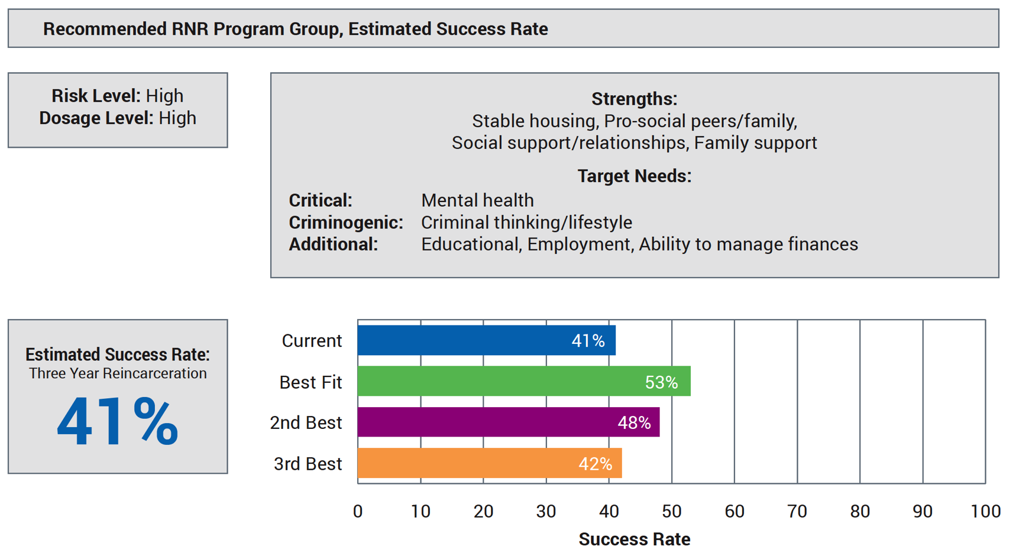
Examples are ….
RNR Simulation Tool (www.gmuace.org/tools) for justice involvement

Slide 26
In conclusion
Pragmatic Approach
Focus on Core Behaviors (SUD, MH, DV, Assaults, Personal Violence)
Use Positive Enforcements
Officer-Client Relationship

Slide 27
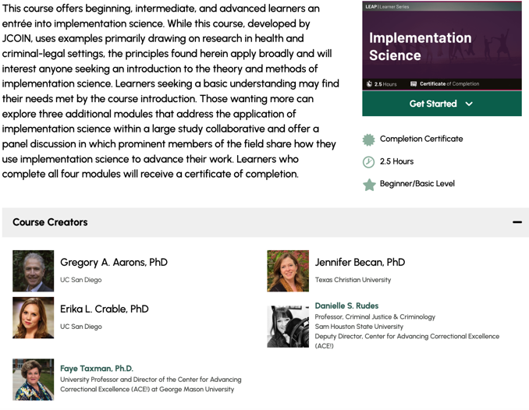
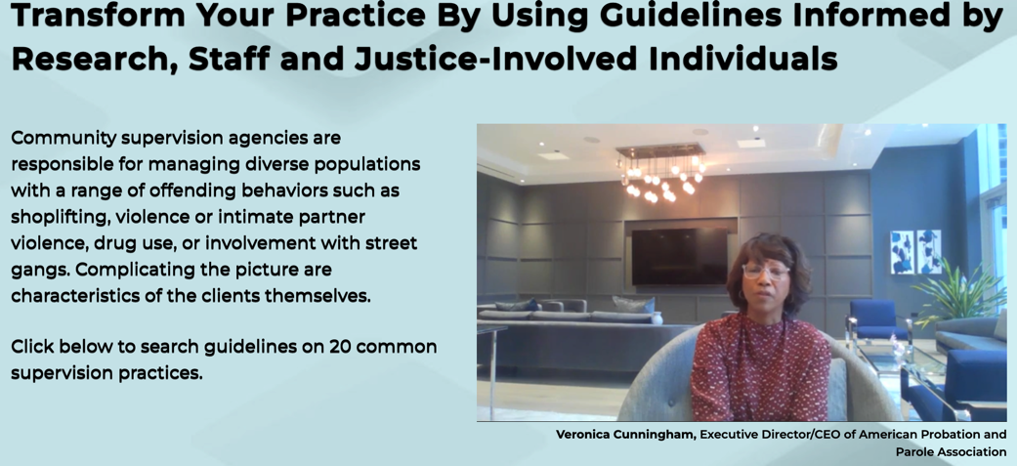
Some Tools
https://www.gmuace.org/major-projects/rnr-simulation-tool/
https://www.jcoinctc.org/courses/leap-learner-implementation-science/
https://www.gmuace.org/appropriateness-statement-package

